Slide 1
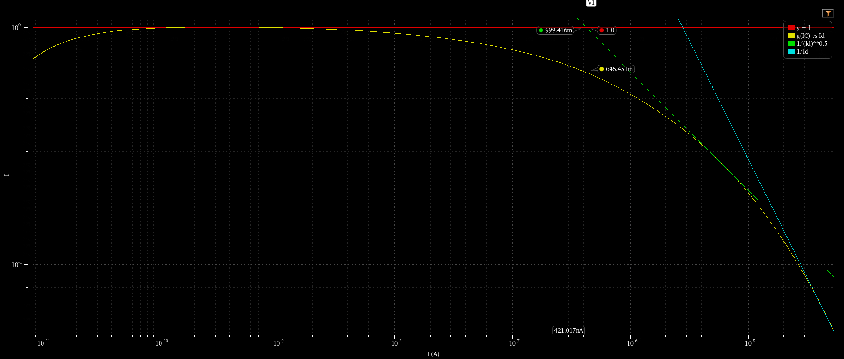
nUTxgm/ID as a function of ID for W/L=1 green is fit with 1/sqrt(ID) fitted asymptote
ISPEC~0.5uA from asymptotes intersection corresponding to square law gm
cyan reflects velocity saturation
If you design a 1mA LNA and want IC=1, where linear behavior is obtained
You should use W/L=2000
e.g. L=65nm, W=130um
Limit W to 2um and use 65 fingers
For the DC biasing MOS use e.g. ~100uA and 6 fingers
Add R (10k) in between and couple RF via large C and source with 50Ohm Rs

